Slide 1

CREDIT CARD
FRAUD DETECTION

Slide 2
INTRODUCTION
The dataset consist of various credit card transaction some are fraud and some are genuine. Learning from this data set we have to predict if the transaction is fraud or genuine and take preventive measures to stop the fraudulent transaction.
Credit card refers to a scammer using your credit card number and PIN or your stolen credit card for financial transaction from your account and without your knowledge
It is a big issue for customer as well as bank because this leads to loss of money . Bank needs to take appropriate steps prevent the loss of customer and money

Slide 3
Project Objective
To understand the transaction that are fraud.
Identifying different patterns or methods used in the fraud transaction.
Using different ML algorithm to predict the best output.

Slide 4
Dataset description
The dataset is in CSV format
There are 284807 rows and 31 column is the dataset
There are no missing value in the dataset
The output/target variable is Class means the data is divided in 0/1
There is 30 input column and 1 output column
All column are scaled to a single unit expect for Time and Amount

Slide 5
Dataset Overview and preprocessing
After doing preprocessing we understand that the data does not contain null values
It does not contain object type variable
The only thing we see over here is applying standardScaling on Time and Amount column to bring all the values to a single scale.
Since the frequency of class 0 is much more than the frequency of class 1 hence we will also be performing sampling technique to balance the data

Slide 6
Algorithm Used for prediction
This classification dataset is solved using below mentioned algorithm after splitting the dataset into output and input column
1.Logistic Regression
2.Decision Tree Classifier(GINI index, entropy, max_depth, min_samples_leaf)
Support Vector Machine(Linear, polynomial, radial kernel function)

Slide 7
Ensembling techniques used for prediction
Boosting Technique
ADA Boost, Gradient Boost, Extreme Gradient Boost
Stacking
Random Forest Tree

Slide 8
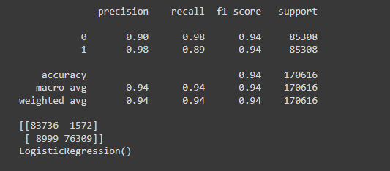
classification report and confusion Matrix of Logistic regression

Slide 9
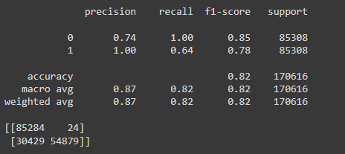
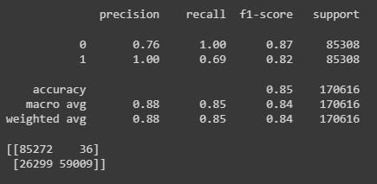
classification report and confusion Matrix of Decision Tree(GiNi index and Entropy)
GINI Index
entropy

Slide 10
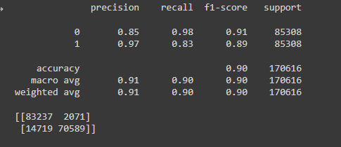
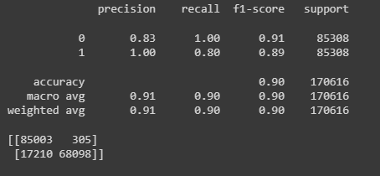
classification report and confusion Matrix of Decision Tree(entropy-Pruning technique)
Max depth
Min samples leaf

Slide 11
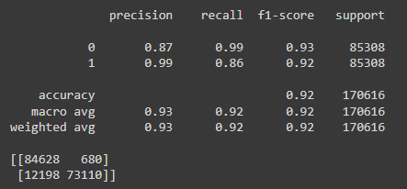
Best classification report and confusion matrix found from ensembling technique
Below report is found by Extreme Gradient Boosting (XGB) of boosting technique

Slide 12
Conclusion
After training the dataset with various algorithm we have come to the conclusion that extreme gradient boosting is giving us the best score.
It can happen that there might be some situation where the machine will get confused between the fraud and genuine transaction because Machine Learning does not give 100% correct prediction and we saw that through the score aswell .
Now we can actually take preventive measures to identify and block such fraude transaction in future.

